Slide 1
Creating & Evaluating Quizzes, Tests & Assignments
Karyn Sproles, Julie Zhu, & Maria Koshute

Slide 2
Types of quizzes & tests
Multiple Choice
True/False
Matching
Performance item; e.g., equations
Short answer
Essay

Slide 3
Common mistakes
Making a test that takes too much time to complete
Spending less time creating a quiz or test (= more time grading it)
Not sharing the grading rubric for essays with students prior to testing
Not having enough questions (less reliability)
Not using Blackboard analytics to test the test
Instructions that are not clear
Not providing an example of a successful solution
Trick questions (usually by accident)
Questions that depend on previous items

Slide 5
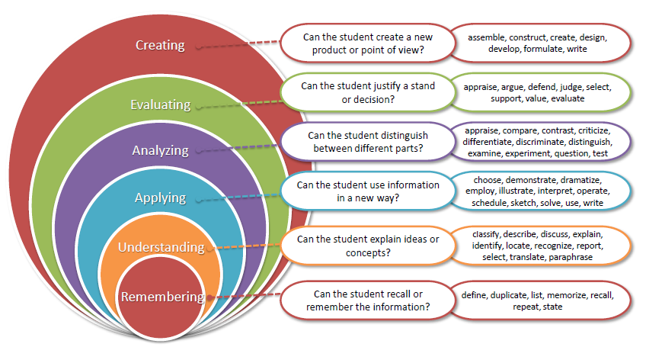
Bloom’s Revised Taxonomy

Slide 6
Jake Crippes, 2nd LT
Ask a former midshipman!

